Slide 1
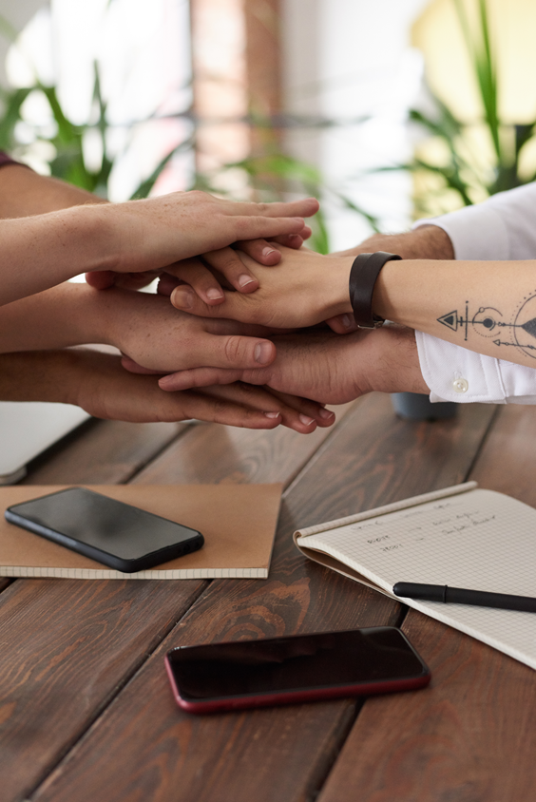
Gearing up with 'Armor' Before Setting Sail on the Startup Journey

Slide 2
A Global Crisis is Always Around the Corner
2000
2001
2008
2011
2014
2016
2020
Dot-Com Crash
9/11 Crash
Global Financial Meltdown.
Fukushima Nuclear Disaster
Crude Oil Crisis
Brexit
Covid-19
Global crises increase the risk of failure for early stage and later stage start-ups alike. Evidence from Israel shows that key to overcoming crises is internationalization, an expansionist commercial mind-set and a readiness to rethink and reposition yourself.
Our aim is to give start-ups new tools to be more resilient when crises hit and inspire them to apply Israeli start-up methodologies. This project is funded by THE DANISH INDUSTRY FOUNDATION.

Slide 3
The Israeli Startup Ecosystem
350+
6,670+
340+
R&D Centers
(multi-nationals)
active companies
VC Funds
63
250+
320k+
Academic Institutions
Accelerators & Incubators
Higher Education students

Slide 4
On the Menu Today:
Becoming an Unstoppable Founding Team
Building Our Support Network of Advisors & Fans
Engaging & Outreach to Maximize Value

Slide 5
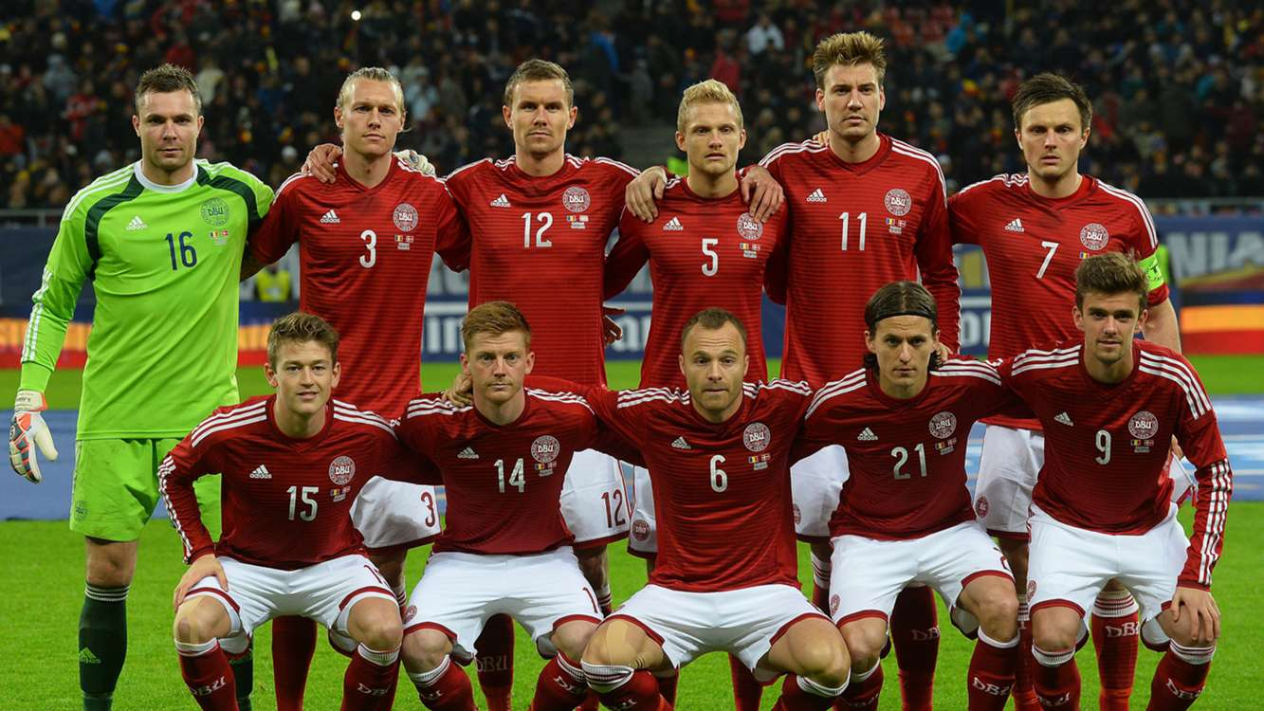
Becoming an Unstoppable Founding Team

Slide 6
Disclaimer

Slide 7
Why startups fail?

Slide 8
“We Are a Rare Breed, a Weird Bird”
?

Slide 9
Unique factors in founding teams:
(but not exclusively)
No clear hierarchy
No strict accountability boundaries
Ambiguity
Risk
Equity

Slide 10
Forming The Team

Slide 11
Forming the team:
Deal Breakers
Structuring the process

Slide 12
Deal Breakers

Slide 13
“All in-ness”

Slide 14
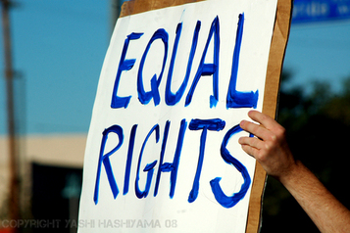
Equality

Slide 15
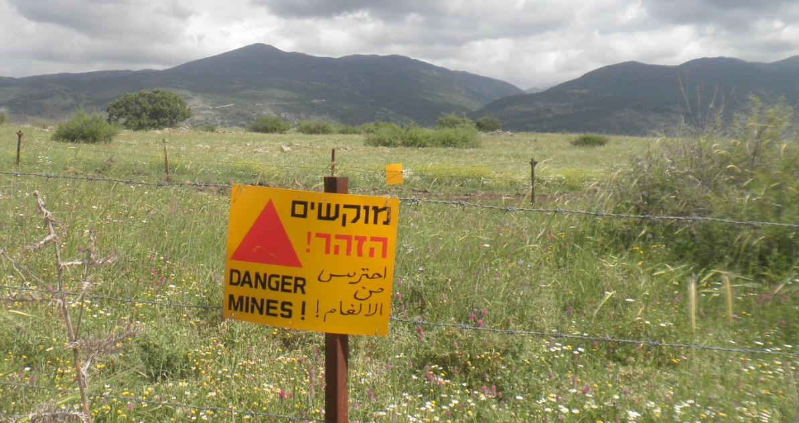
Red Lines

Slide 16
Future Predicaments

Slide 17
Deal Breakers:
“All in-ness”
Equality (Equity & Emotionally)
Red Lines
Future Predicaments (Exit / IPO / Raising)

Slide 18
Deal Breakers Exercise:
Write down all your deal breakers and share with your co-founders
“All in-ness”
Equality (Equity & Emotionally)
Red Lines
Future Predicaments (Exit / IPO / Raising)

Slide 19
Structuring the Process

Slide 20
Structuring the Process
1st Date – Relationship and chemistry
2nd Date – Professional background & Ideation
3rd Date – Project presentation (**2 founders adding 1)
4th Date – Matching expectations – Deal Breakers list + Principles + Characteristics.
“Weekend Trip” – Determine a trail time for working together
5th Date – Tying the knot – Processing Weekend trip & conclusions

Slide 21
Characteristics of Unstoppable Teams

Slide 22
Characteristics
Observation 1 (Foundation):
Ideas Vs. Relationships

Slide 23
Characteristics
Observation 2 (Founder-Problem-Fit):
Skillset & Motivation

Slide 24
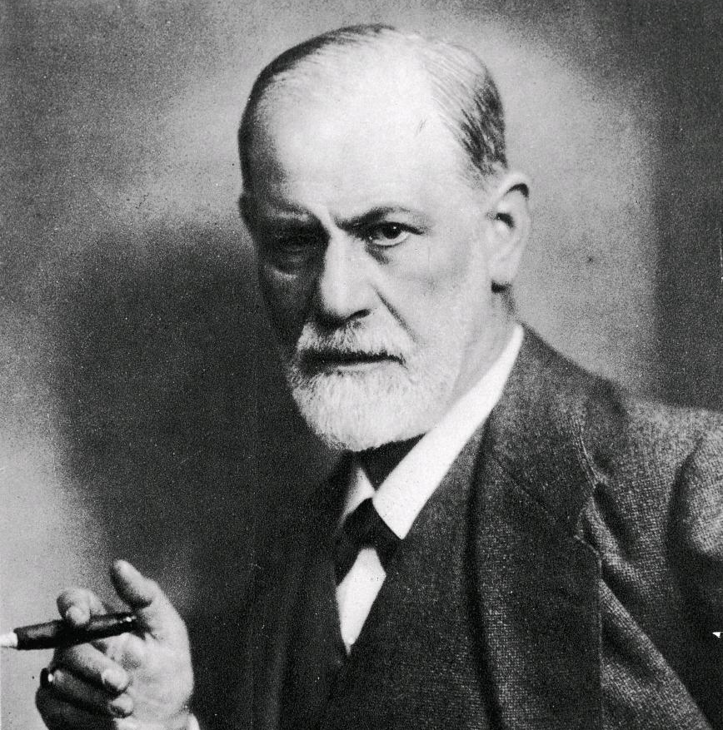
Characteristics
Observation 3 (Emotional Management):
Ego – Two Dimensions

Slide 25
Characteristics
Observation 4 (Communication):
Elephants

Slide 26
Characteristics
Observation 5 (Values):
Vision & Context

Slide 27
Characteristics
Observation 6 (Direction):
Messaging Alignment

Slide 28
Characteristics
Observation 7 (No B.S):
Speed & Focus

Slide 29
Characteristics Summary:
Ideas Vs. Relationships
Skillset & Motivation
Two levels of Ego
Elephants
Vision & Context
Messaging & Alignment
Speed & Focus

Slide 30
Key Principles of Unstoppable Founders

Slide 31
Principles
Accountability
“When it comes to privacy and accountability, people always demand the former for themselves and the latter for everyone else.”
- David Brin, Sci-Fi Author.
It cannot be shared!

Slide 32
Principles
(professional)Integrity
“Integrity is the essence of everything successful.”
- Buckminster Fuller, Famous American Architect
There is never too much of it

Slide 33
Principles
Relationships Background
“It’s not you, it’s me!”
- Seinfeld, Funny Guy
Nothing is personal

Slide 34
Principles
Completion
“Just do your job.”
(Even the part you’d rather not to)
- Every movie. Ever
Don’t leave loose ends

Slide 35
Principles
Why - Context
“I’d sell my soul for a good cause”
- Hugh Jackman
Remember your ‘why’ at all times.
Remind others too.

Slide 36
Accountability Integrity Relationship Background Completion Why - Context
Principles:

Slide 37
Introducing ‘PTs’ (personal talks)
Let’s do one now ☺
Brainstorm your top “interview” questions you would like to pose to a potential co-founder. Ask them. Reflect on the answers you got and if they have achieved their goals.
Take 20 minutes and ‘PT’ with one another.

Slide 38
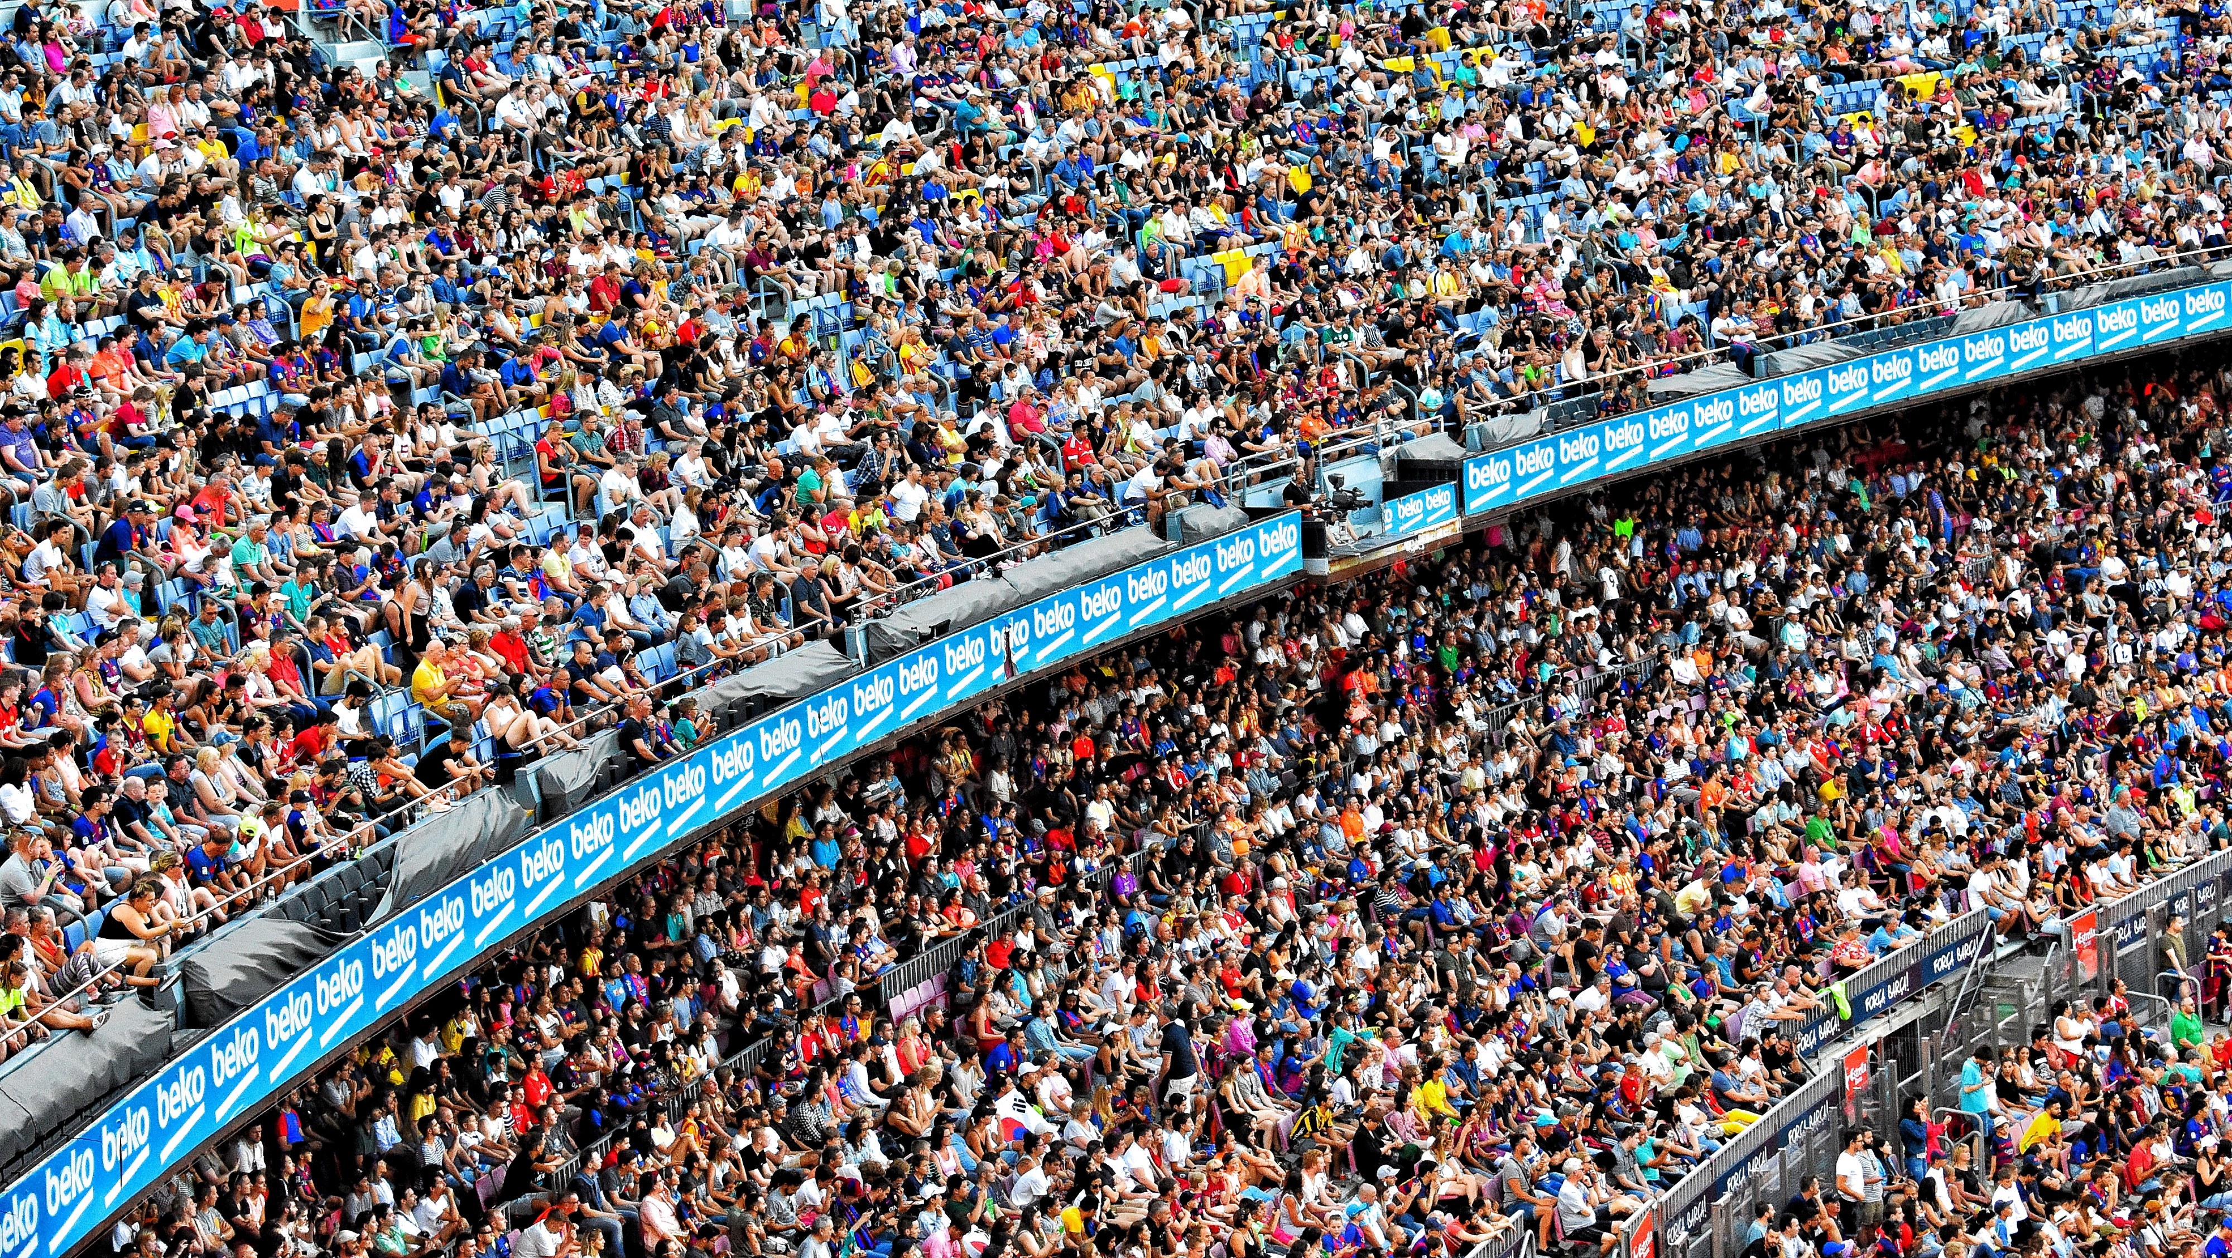
Building Our Support Network of Advisors & Fans

Slide 39
The main principle:
H2H
Human to Human Approach

Slide 40
First Step: Relationship Goals ☺:
Where am I in venture stage and what are my current objectives?
How can my network help? Who are the people I need to further advance?
What is the ‘ask’ from these people?

Slide 41
Case – Venture Founder
Where am I in venture stage and what are my current objectives?
I’m trying to raise money for my venture
Problem exploration in Industry [insert name]
How can my network help? Who are the people I need to further advance?
Investors // People who can introduce
Potential customer // People who can introduce
What is the ‘ask’ from these people?
Introduction (if not direct)’
Their opinion / Expertise (direct)

Slide 42
Mapping Channels & Opportunities for building
The Network

Slide 43
“The best time to build relationships is when you least need them”

Slide 44
Mapping Channels & Opportunities for building
The Network
Myths & Norms
Things you should really know
How to Start?
Ready, set, go!
Management
Cause’ it’s just too much

Slide 45
Extroverts
Small Talk?
4 Myths
Quantity
Matters
It’s Fake

Slide 46
The “Norms”
Attention
Remember
Quality
Give (a lot!)
Relationships
A small pond
NAME!
Anything family related
Health related
Big career / business pointers

Slide 47
How to Start?
Defining objectives (done!)
Mapping Initial assets
Low Hanging Fruit
Approaching (next part)
Mapping Channels & Opportunities

Slide 48
Practice - How to Start?
Define objective:
Get introductions to 10 potential clients / VCs
Mapping initial assets locations:
Prioritizing based on “low hanging fruit”
Mapping Channels & Opportunities

Slide 49
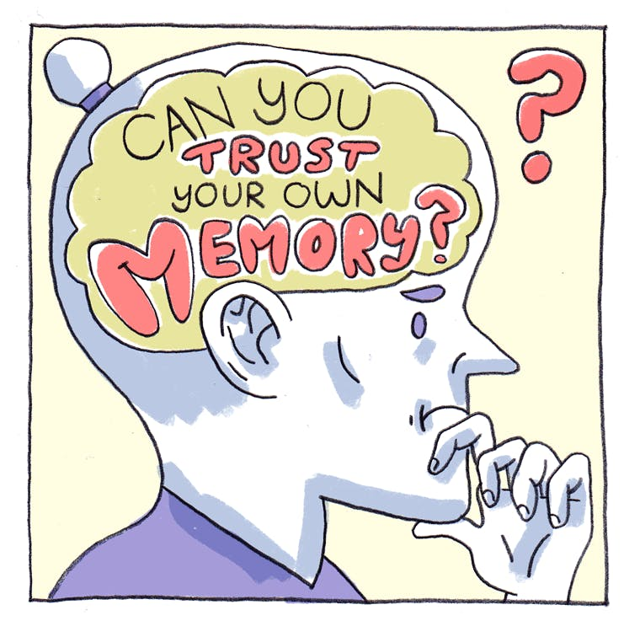
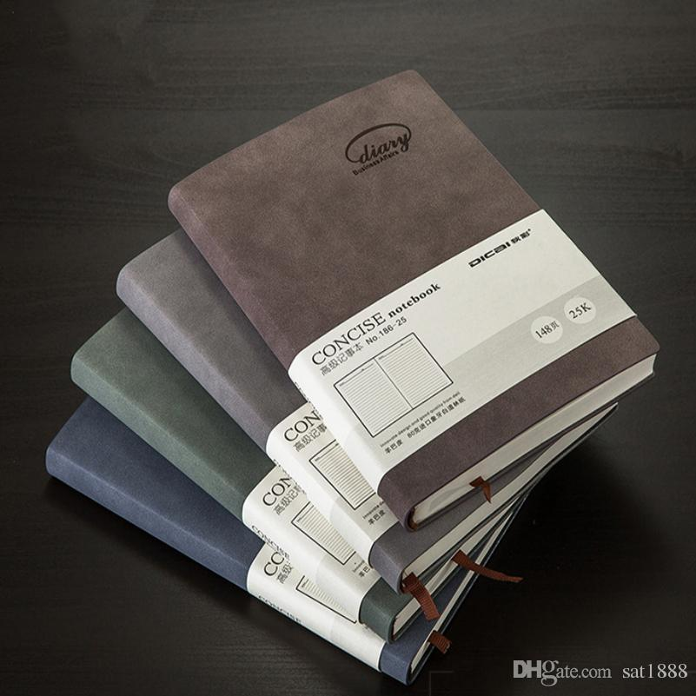
Managing The Network:
Mapping Channels & Opportunities

Slide 50
Managing The Network:
CRM
E-Mail Addons
Gmelius
Calendar
‘Available’
(On Product Hunt)

Slide 51
My use cases:
- Managing holistic DBs of contacts.
- Pipeline visibility
- Automatic reminders, templates, MM
- Booking at scale.
‘Available’
(On Product Hunt)
- Concierge booking.

Slide 52
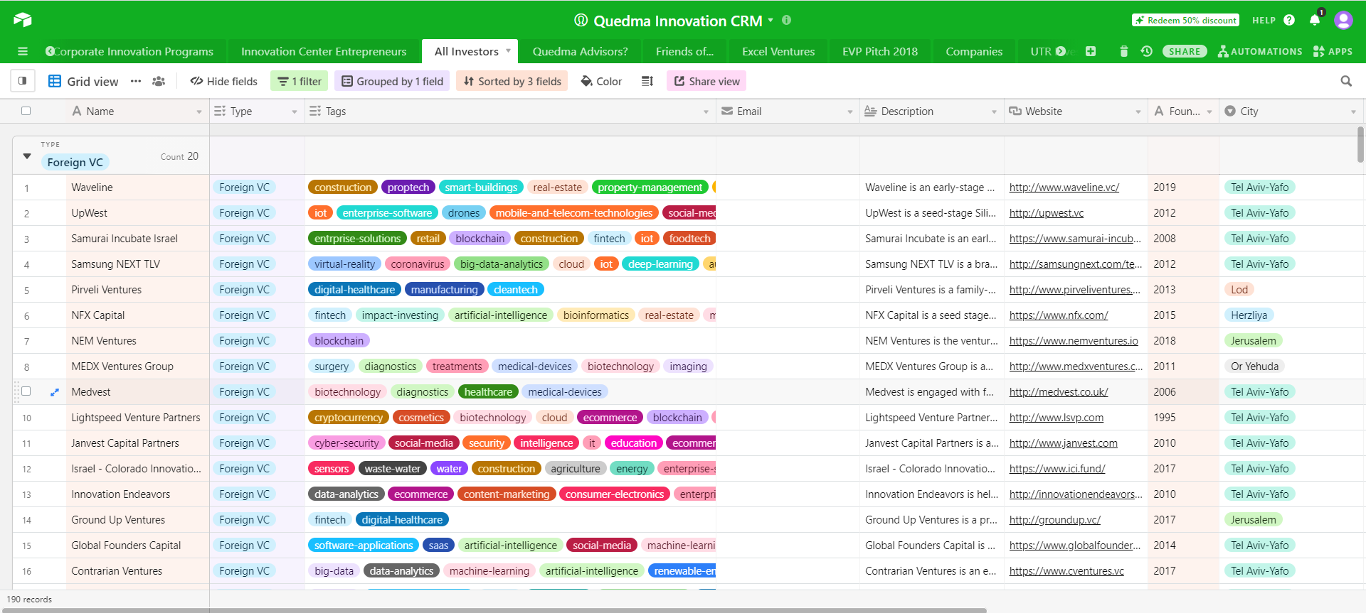
Example CRM

Slide 53
Choosing an Advisors Board
Startup
The Super Networker
The Challenger / Veteran
The Sector Expert

Slide 54
Choosing an Advisors Board
Startup
The Super Networker
The Challenger / Veteran
The Sector Expert
Has access to customers / funding / regulation.
Experienced and challenges you to grow.
Build your credibility and boosts your tech.

Slide 55
Things to look for:
Is interested in an equity stake (skin-in-the-game).
Truly adds value and the framework of work is defined.
Has a good reputation and experience in your specific field of work.
Can go with you a long way and not relevant just for the early stages (global reach / brand / network / knowledge).

Slide 56
Exercise: Setting up our network
Define 2-3 objectives.
Map relevant 10 contacts from your networks.
Create a CRM.
Define relevant fields and input individuals you have allocated and how you can engage with them.

Slide 57
Engaging & Outreach to Maximize Value

Slide 58
What is an entrepreneur’s most important skill?

Slide 60
Best practices for
Managing meetings.
Managing relationships.
Making the most of your network.

Slide 61
1. Managing Meetings

Slide 62
Before
During
Post
Before the meeting
Homework:
Background (how can X help)
Motivations (why would X help)
Outcome (what do we want from X + action item + how do we want X to feel/think/remember)
Plan (how do we get X to ‘Outcome’)

Slide 63
Homework
Prep
Manage
Future
Background
Source
CV
Mapping Motivation
Personal
Organizational
Similarities
Professional
Personal
Homework
Emotional Management
Execution

Slide 64
Execution:
Prep
Manage
Future
Meeting Agenda
A must?
Nice to have?
The Goal?
What Will Be Considered Success?
Key Action Item?
Homework
Emotional Management
Execution

Slide 65
Emotional Management:
Prep
Manage
Future
What are my concerns?
Who will I be in the meeting?
What can prevent success?
How will I ‘leave’ the other side?
Homework
Emotional Management
Execution

Slide 66
Before
During
Post
During the meeting
Tips
Be likeable
Be memorable
Be a ‘promise’
EQ > IQ
Be good listeners
Emotional management
Context & framing
State your expectations / goals
Show interest - Write down summary
Purple Cow (selfie, giveaway, question)
What can you do for them?
Be thankful. Be polite. Clean up.

Slide 67
Before
During
Post
After the meeting
To Do’s
Follow-up email + meeting summary (24h)
Update CRM
Set next interaction reminder
Connect on social networks (depending on relationship)

Slide 68
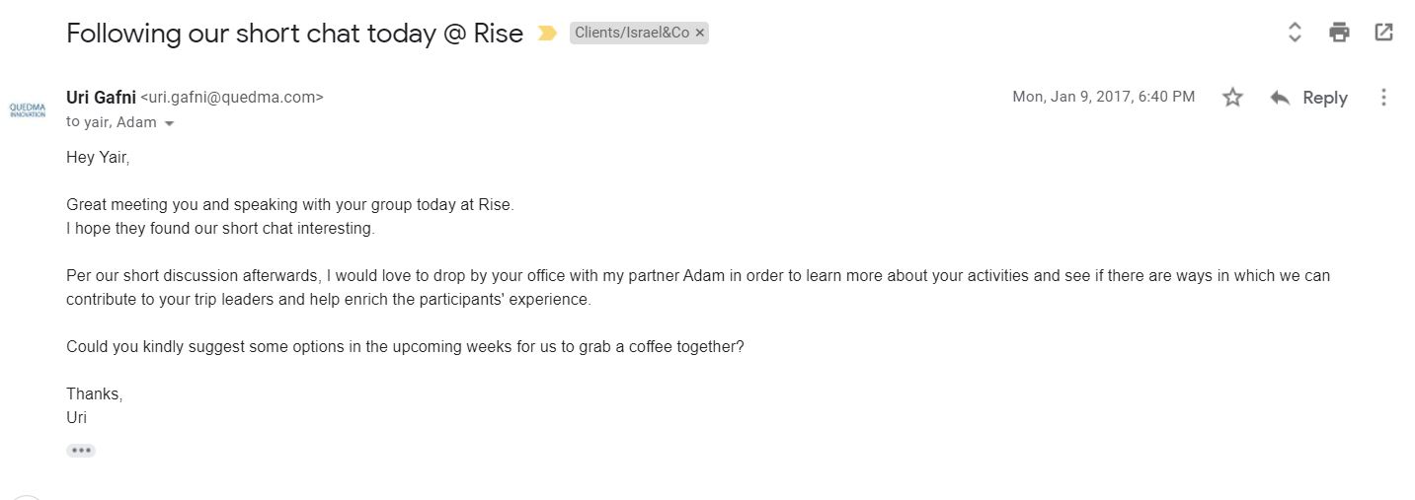
Before
During
Post
Example Follow-Up Email

Slide 69
2. Managing Relationships

Slide 70
Managing a meeting is easy
Managing a relationship is hard

Slide 71
“The best time to build a relationship is when you least need it”

Slide 72
Managing Relationships
To Do’s
Progress updates (weekly/monthly/milestone)
Ask for advice (even when unneeded)
Personal Interest > Professional
Special feeling (personal touch, holidays, gifts, cards)

Slide 73
Warm Vs. Cold
Introductions
Tools of the Trade

Slide 74
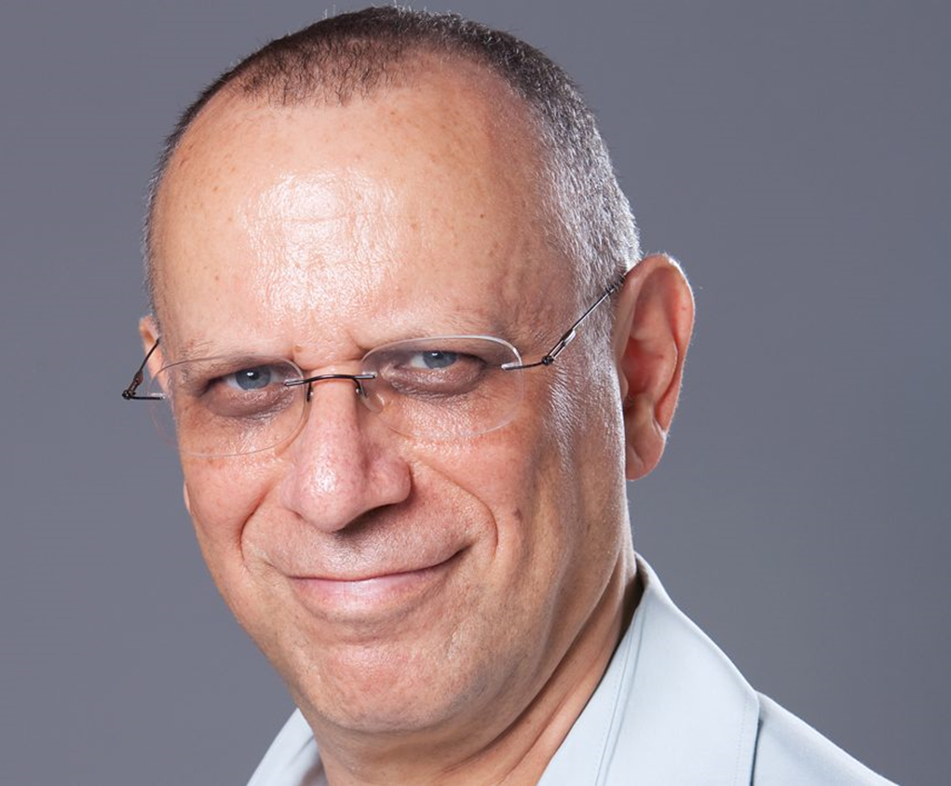
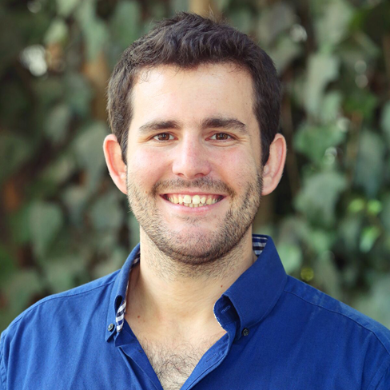
Intro
_{Understanding the Relationship}

Slide 75
Intro
Walking in Their Shoes
Answer Fast!
Be a pro
Make it easy for friend
Consider your introducer

Slide 76
Intro
Walking in Their Shoes
Do you trust “Adam”?
Is it a right fit?
Timing?
Am I being too much?

Slide 77
Intro Blurb
Goal:
Making it easy for our network to introduce us to new people
Best used:
When we need the help of others to reach new individuals
Guidelines:
Write in the introducers voice
Be soft on the marketing
Use your elevator pitch!

Slide 78
Additional materials needed for the blurb? “MVB”

Slide 79
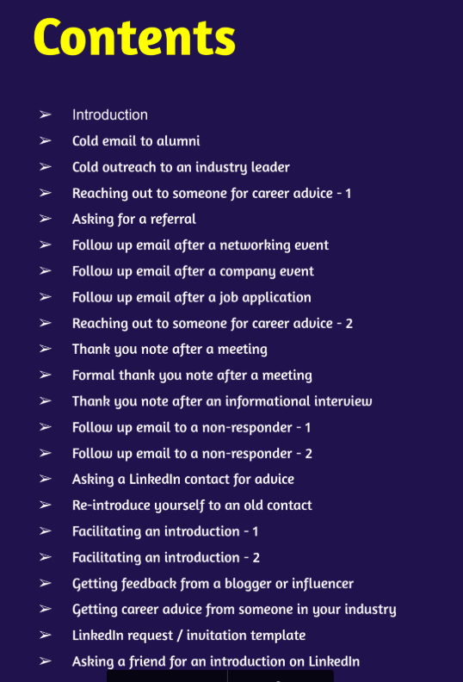
Networking Emails
Notes:
https://www.networkingemails.com/premium-download/NetworkingEmailsBook-ResumeWorded.pdf

Slide 80
Write a short introduction blurb for you and your venture. Up to 6 sentences.
Depict who is introducing you and to whom.
Notes:
https://www.networkingemails.com/premium-download/NetworkingEmailsBook-ResumeWorded.pdf

Slide 81
3. Making the Most of Your Network & the Mentors

Slide 82
Remember this?
CRM
E-Mail Addons
Gmelius
Calendar
‘Available’
(On Product Hunt)

Slide 83
Tips:
Accurately built CRM – one person accountable
Each ‘supporter’ – one person accountable
Constant updates & relationship management + Periodical summary email
Pull vs. Push
Want an intro? = blurb
Got an intro? = update afterwards

Slide 84
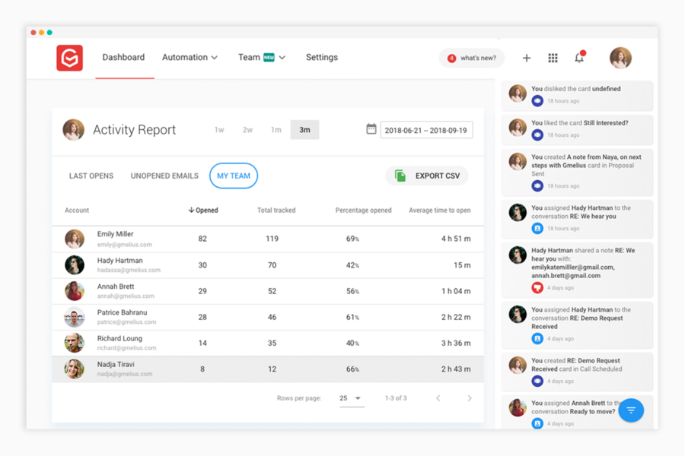
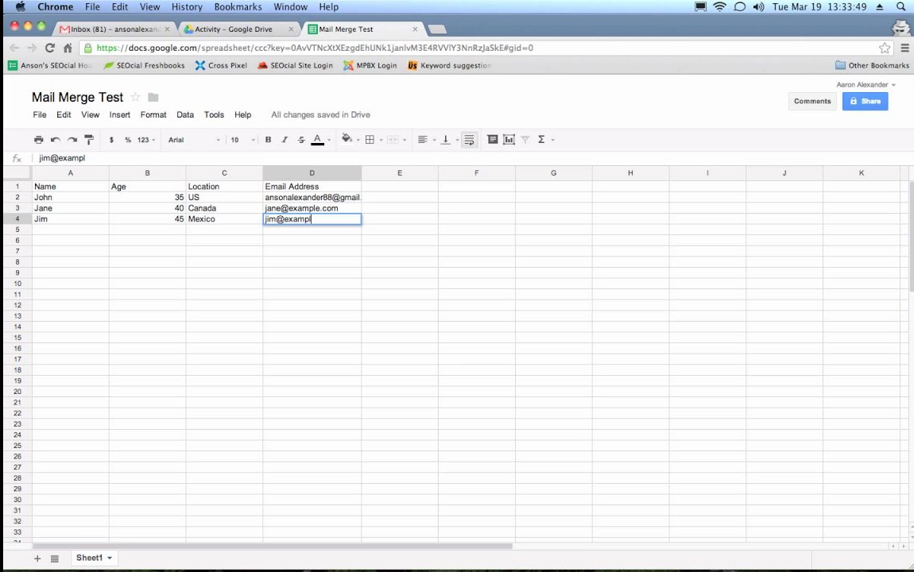
Mail Merge

Slide 85
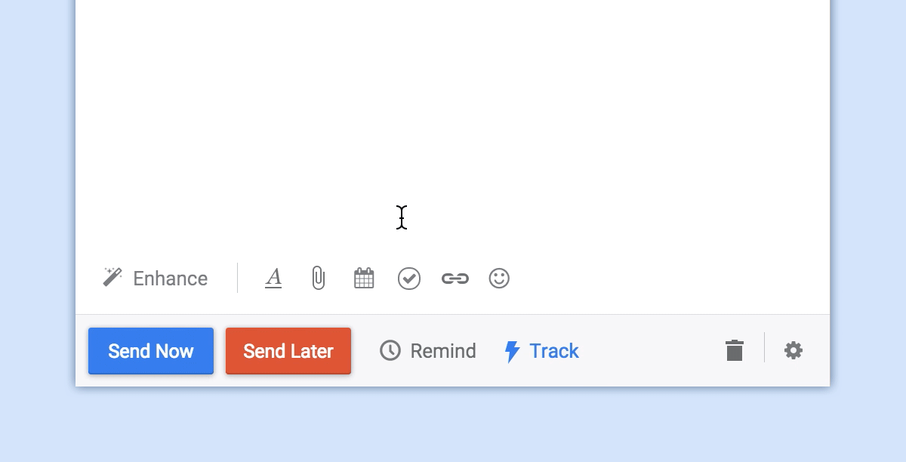
Scheduling Meetings

Slide 86
Mastering Emails - Hacks
Snoozes
Automated follow-ups
Send-laters
Tracking
Templates
Sequences

Slide 87
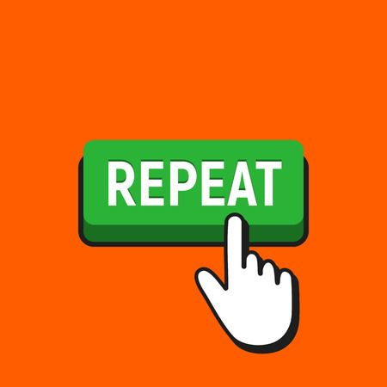
Relationship Building Process Summary:
Write down goals
Assess needed resources
Map network
Install management tools
Create minimal approach toolkit
Approach – intro / elevator / cold
Follow-up
Schedule meeting / call
Follow-up with action items
Manage relationship
Meeting Mastery

Slide 88
10 Takeaways to Remember:
Be focused on your work – set goals
Is it marketing / sales / business development?
You can’t remember it all – manage the process
You have more useful connections then you think
Be a pro in your communication
Close it while its hot – move fast
Remind people you exist – mailing lists / Social Media
Follow-up always
Prepare for meetings – its your brand
It’s a long process – and not all of it is fun
Meeting Mastery

Slide 89
Thanks!
Meeting Mastery

